Slide 1

Data Lake
Unit 4: Dr. Yousefi

Slide 2
Objectives:
Examine the most common challenges of managing streaming data analytics—a mix of streaming and at-rest data collection, measurement, tracking, analysis, security and reporting.
Unit 4 - Discussion Board (75 points)
Unit 4 - Individual Project (125 points)
Unit 4 - Live Chat Extra Credit Summary (15 points)

Slide 3

Discussion
Primary Response: Within the Discussion Board area, write 300-500 words that respond to the following questions with your thoughts, ideas, and comments. This will be the foundation for future discussions by your classmates. Be substantive and clear and use examples to reinforce your ideas.
For this Discussion Board, please complete the following:
The term data lake emerged to represent the ability to store large amounts of data in a low-cost data storage architecture such as Hadoop. Then, once stored, the data could be "fished out" as needed for various purposes. For this activity, you will research big data architectures that enable data lakes.

Slide 4
Discussion
An example of this can be seen in data regarding COVID-19. About COVID-19, imagine how much data are tracked and stored as big data on COVID-19 vaccines.
This article discusses the process of COVID-19 vaccines data.
Based on the article and what you have learned about data lakes, data management, and data collection, what do you think a data lake for COVID-19 vaccine data looks like?
Share a security issue that may arise from all the nationwide data.
What could be done to help secure the COVID-19 data lake?

Slide 5

IP4
Data lakes can include at-rest and streaming data because these two data sources often need to be combined. By evaluating the tools within a big data ecosystem, a combination of these can be used.
For this assignment, you will utilize data from both concepts to gather incremental changes as they occur.
While the data lake will not be populated, the architecture and design will consume and operate so that the destination could be many sources, including a data lake.

Slide 6

IP explanation
Assignment Details
Data lakes can include at-rest and streaming data because these two data sources often need to be combined. By evaluating the tools within a big data ecosystem, the combination of these can be used.
For this assignment, you will utilize data from both concepts to gather incremental changes as they occur. While the data lake will not be populated, the architecture and design will consume and operate so that the destination could be many sources, including a data lake.

Slide 7
IP4
The project deliverables include the following:
Consume data from https://www.pubnub.com/developers/realtime-data-streams/wikipedia-changes/.
Demo: Easily connect and consume real-time streaming data | PubNub
Consume the data locally on your PC using Python.
Construct a query algorithm that produces an incremental number of changes in real-time. The Python code will require the use of a streaming library of your choosing.
Once complete, submit your assignment for grading in a Microsoft Word document.

Slide 8
IP requirements
The project deliverables include the following:
Consume data from this link.
Consume the data locally on your PC using Python.
Construct a query algorithm that produces an incremental number of changes in real time. The Python code will require the use of a streaming library of your choosing.
Once complete, submit your assignment for grading in Microsoft Word document.

Slide 9
Step 2
Consume the data locally on your PC using Python.
Python

Slide 10
Construct a query algorithm that produces an incremental number of changes in real time.
Algorithm to generate incremental numbers up to a fixed number
How to make streaming date

Slide 11
algorithm that produces an incremental
It's hard to do much better than a brute-force approach here. You can discard any number that is divisible by another number in the list. Then, you can use the following algorithm:
lst = [12,13,17]
target = 50
sums = {0}
for i in lst:
new_sums = set()
for j in sums:
x = j + i
while x <= target and x not in new_sums:
new_sums.add(x)
x += i
sums = sums.union(new_sums)
print(sums)
# {0, 12, 13, 17, 24,

Slide 12
Incremental algorithms
An incremental algorithm is given a sequence of input and finds a sequence of solutions that build incrementally while adapting to the changes in the input.
Online algorithms also take in a sequence of input and produce incremental solutions; unlike their incremental counterparts, they do not know the input sequence in advance.

Slide 13

Incremental algorithms
We use our incremental results to better understand online algorithms and indicate how their performance can be improved.to understand online algorithms better

Slide 14
What Is Incremental Learning?
Incremental learning, or online learning, is a branch of machine learning that involves processing incoming data from a data stream—continuously and in real-time—possibly given little to no knowledge of the distribution of the predictor variables, sample size, aspects of the prediction or objective function (including adequate tuning parameter values), and whether the observations have labels.

Slide 15

Incremental Learning Functions
The incremental learning model object specifies all aspects of the incremental learning algorithm, from training and model evaluation preparation through training and model evaluation.
To implement incremental learning, you pass the configured incremental learning model to an incremental fitting or model evaluation function.

Slide 16

Incremental Learning Functions
You can find the list of supported incremental learning functions in the Object Functions section of each incremental learning model object page.
Statistics and Machine Learning Toolbox incremental learning functions offer two workflows well suited for prequential learning.

Slide 17
Incremental Learning Functions
For simplicity, the following workflow descriptions assume that the model is prepared to evaluate the model performance (in other words, the model is warm).
An incremental learning model object fully specifies how functions implement incremental fitting and model performance evaluation.

Slide 18
Configure Incremental Learning Model
To configure (or prepare) an incremental learning model, create one by calling the object directly or by converting a traditionally trained model to one of the objects.
The following table lists the available model types, model objects for incremental learning, and conversion functions.

Slide 19

Link
https://www.mathworks.com/help/stats/configure-incremental-learning-model.html

Slide 20

Analysis of Algorithms
As people gain experience using computers, they use them to solve difficult problems or to process large amounts of data and are invariably led to questions like these:
How long will my program take?
Why does my program run out of memory?

Slide 21

Kafka
Apache Kafka v0.10 introduced a new feature, Kafka Streams API - a client library which can be used for building applications and microservices, where the input and output data can be stored in Kafka clusters.

Slide 22

Kafka
Kafka Streams provides state stores, which can be used by stream processing applications to store and query data.
Every task in Kafka Streams uses one or more state stores which can be accessed via APIs to store and query data required for processing.
These state stores can either be a persistent key-value store, an in-memory hashmap, or another convenient data structure. It also offers fault-tolerance and automatic recovery for local state stores.

Slide 23

Kafka
Kafka Streams allows read-only queries of these state stores by methods, processes or external applications.
This is provided through a feature called Interactive Queries. Interactive queries were designed to give developers access to the internal state or state stores of a stream processing application

Slide 24
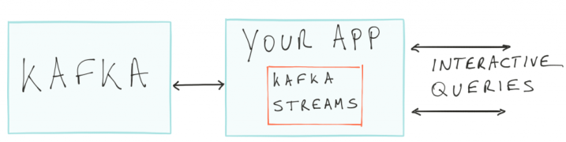
Eliminating the Need for an External Database
With Interactive Queries and Apache Kafka, we can eliminate the need for an external database by making all the states of your application quarriable through the Interactive Query API.

Slide 25
Eliminating the Need for an External Database
Kafka Streams library maintains the internal state through embedded databases (the default is Rocks DB, but one can plug in their own).
Now, These embedded databases act as materialized views of logs that are stored in Apache Kafka. With the help of Interactive Queries, we can directly expose this embedded state to applications.

Slide 26
Making a Kafka Streams Application Queryable
Kafka Streams handle most of the low-level querying, metadata discovery, and data fault tolerance.
Depending on the application, one can query directly with no extra work (local state stores) or might have to implement a layer of indirection for distributed querying (remote state stores).

Slide 27
Querying Local State Stores
Since a Kafka Streams application typically runs on multiple instances, the state that is locally available on any given instance is only a subset of the entire state of the application.
Querying the local state stores on an instance returns the data which is locally available on that instance.

Slide 28
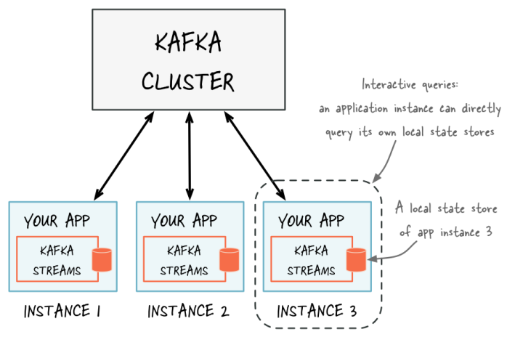

Slide 29
Querying Local State Stores
The example below has a KStream of textLines and it further creates a key-value store named "CountsKeyValueStore" which will be responsible for holding the latest count for any word that is found on the topic "word-count-input."

Slide 30

Querying Local State Stores
// Define the processing topology (here: WordCount)
KGroupedStream&amp;amp;amp;amp;amp;lt;String,
String&amp;amp;amp;amp;amp;gt; groupedByWord = textLines
.flatMapValues(value -&amp;amp;amp;amp;amp;gt; Arrays.asList(value.toLowerCase().split("\\W+")))
.groupBy((key, word) -&amp;amp;amp;amp;amp;gt; word, Serialized
.with(stringSerde, stringSerde));// Create a key-value store named "CountsKeyValueStore" for all the word countsgroupedByWord.count(Materialized.&amp;amp;amp;amp;amp;lt;String, String, KeyValueStore&amp;amp;amp;amp;amp;lt;Bytes, byte[]&amp;amp;amp;amp;amp;gt;as("CountsKeyValueStore"));// Start an instance of the topologyKafkaStreams streams = new KafkaStreams(builder, config);streams.start();

Slide 31

Querying Local State Stores
After the application has started, you can query the "CountsKeyValueStore" using the ReadOnlyKeyValueStore API. It can be done in the following manner:
1// Get the key-value store CountsKeyValueStore
2ReadOnlyKeyValueStore keyValueStore =
3streams.store("CountsKeyValueStore", QueryableStoreTypes.keyValueStore());

Slide 32
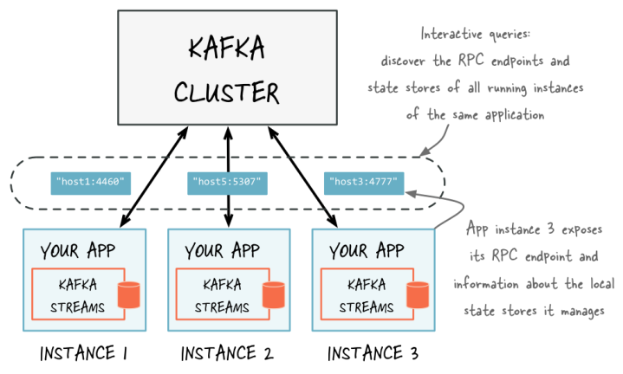
Querying Remote State Stores
To query remote states for the entire app, you must expose the application's full state to other applications, including applications that are running on different machines.

Slide 33

Below are the steps needed to query remote state stores and make the full state of the stream processing application quarriable:
Add an RPC Layer to Your Application
This helps the instances of your application to interact via the network.
The RPC layer should be embedded within the Kafka Streams application and expose an endpoint through which application instances and applications can connect to it.

Slide 34

Expose the RPC Endpoints
To enable remote state store discovery in a distributed Kafka Streams application, you must expose the RPC endpoint of application instances using the application.server configuration setting of Kafka Streams.
The value of this configuration property is unique for each instance of your application.
It helps in keeping track of the RPC endpoint information for every instance of an application, its state stores, and assigned stream partitions through instances of StreamsMetadata.

Slide 35

Discover Remote Application Instances and Their State Stores
The RPC layer should discover remote application instances and their state stores and query locally available state stores to make the full state of your application quarriable.
The remote application instances can forward queries to other app instances if a particular instance lacks the local data to respond to a query. The locally available state stores can directly respond to queries.

